Slide 1
Moving Image Archives or Open Memory Resources?
Drawing on All Resources
University of Brighton 16/5/12
paul.gerhardt@archivesforcreativity.com

Slide 2
Six propositions:

Slide 3
Six propositions:
Moving image is central to our understanding of the 20th Century

Slide 4
Six propositions:
Moving image is central to our understanding of the 20th Century
Due to increasing demand, significant resources are now available online

Slide 5
Six propositions:
Moving image is central to our understanding of the 20th Century
Due to increasing demand, significant resources are now available online
Our major archives are not equipped to deliver the value locked up in them

Slide 6
Six propositions:
Moving image is central to our understanding of the 20th Century
Due to increasing demand, significant resources are now available online
Our major archives are not equipped to deliver the value locked up in them
We need the analytic methods and research framework to consider moving image in the same terms as text

Slide 7
Six propositions:
Moving image is central to our understanding of the 20th Century
Due to increasing demand, significant resources are now available online
Our major archives are not equipped to deliver the value locked up in them
We need the analytic methods and research framework to consider moving image in the same terms as text
New initiatives are changing the context for our national collections

Slide 8
Six propositions:
Moving image is central to our understanding of the 20th Century
Due to increasing demand, significant resources are now available online
Our major archives are not equipped to deliver the value locked up in them
We need the analytic methods and research framework to consider moving image in the same terms as text
New initiatives are changing the context for our national collections
We have the opportunity to imagine a new future

Slide 9
Six propositions:
Moving image is central to our understanding of the 20th Century
Due to increasing demand, significant resources are now available online
Our major archives are not equipped to deliver the value locked up in them
We need the analytic methods and research framework to consider moving image in the same terms as text
New initiatives are changing the context for our national collections
We have the opportunity to imagine a new future

Slide 10
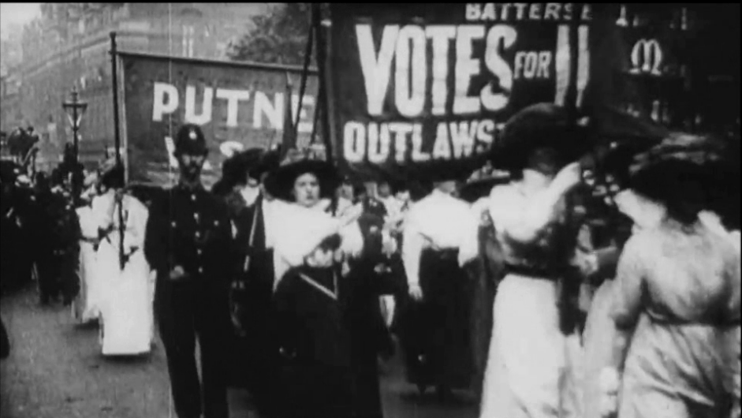
Knowledge Is………

Slide 11
Video on the web:
2008
30% of internet traffic
2010
80% of internet traffic
2014
91% of internet traffic
(Cisco)

Slide 12
Devices and traffic:
11 billion square feet are predicted to be showing images worldwide by 2013, enough to encircle Earth’s entire surface almost 50 times
15 billion network enabled devices will be in use by 2015
by 2013, the equivalent of 10 billion DVDs will be crossing the Internet every month.

Slide 13
The archive is the basis of what can be said in the future about the present when it will have become the past.
(Aleida Assman 2008)

Slide 14
Six propositions:
Moving image is central to our understanding of the 20th Century
Due to increasing demand, significant resources are now available online
Our major archives are not equipped to deliver the value locked up in them
We need the analytic methods and research framework to consider moving image in the same terms as text
New initiatives are changing the context for our national collections
We have the opportunity to imagine a new future

Slide 15
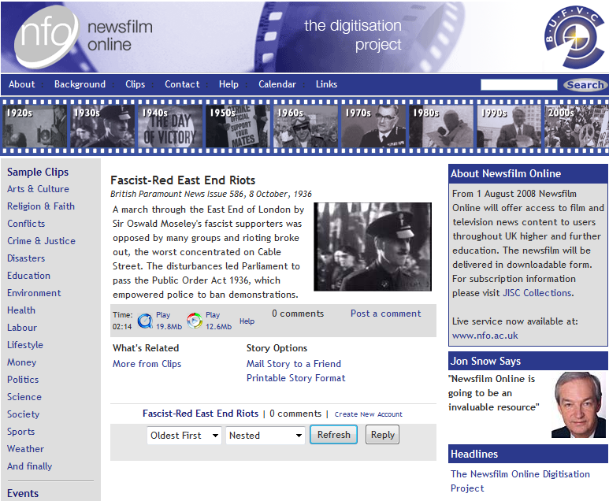
Notes:
Over 3,000 hours of digitised news stories from the ITN/Reuters archives, comprising some 60,000 stories. The sources include the complete Gaumont and Paramount newsreels, from 1910 and 1934 respectively. Previously unbroadcast and unseen material, such as rushes and programme scripts, are also included.

Slide 16
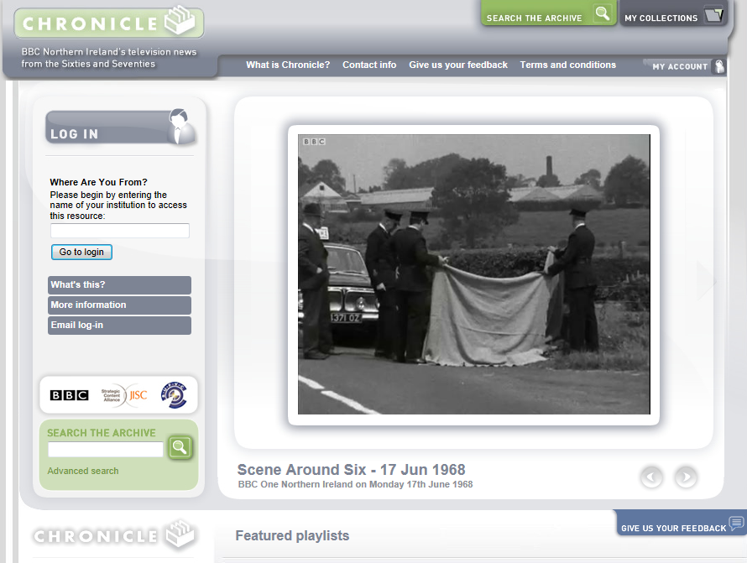

Slide 17
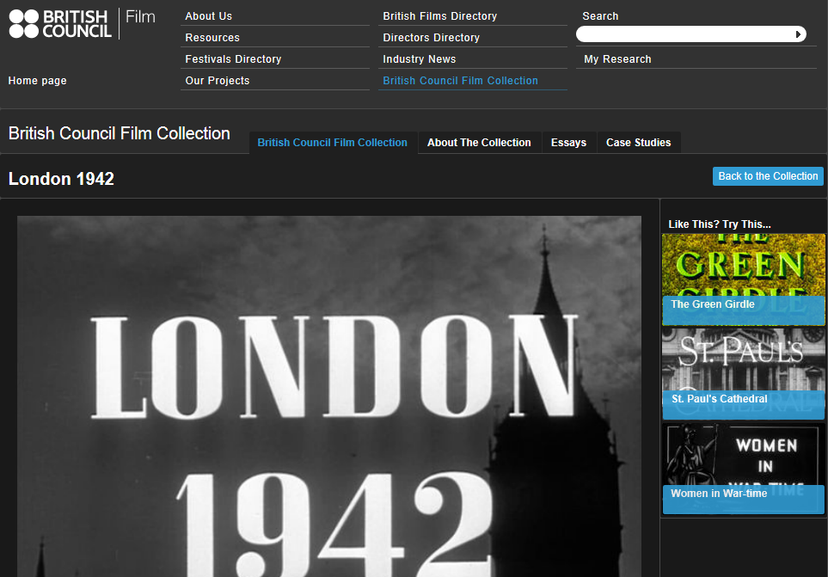

Slide 18
Six propositions:
Moving image is central to our understanding of the 20th Century
Due to increasing demand, significant resources are now available online
Our major archives are not equipped to deliver the value locked up in them
We need the analytic methods and research framework to consider moving image in the same terms as text
New initiatives are changing the context for our national collections
We have the opportunity to imagine a new future

Slide 19
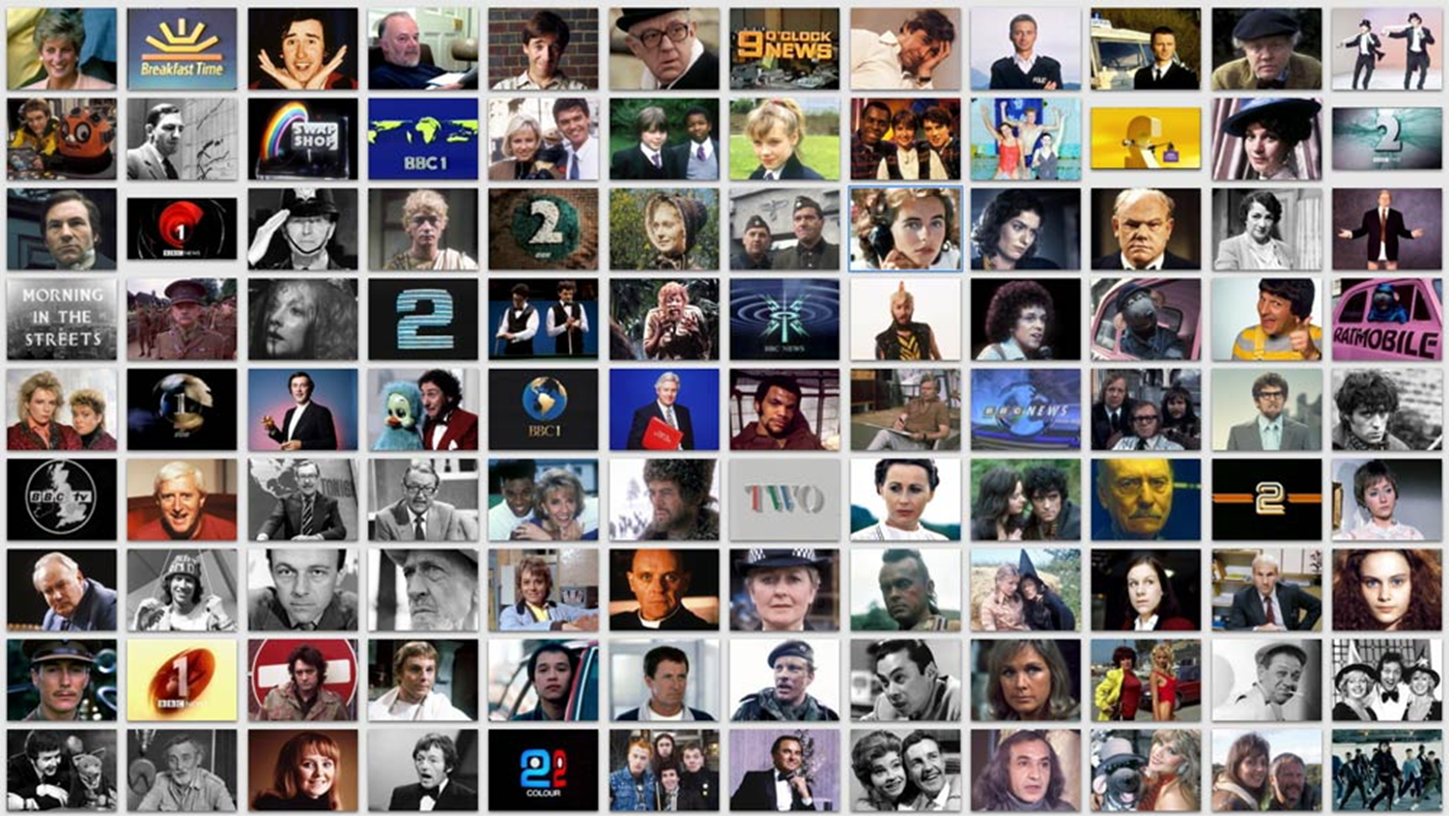

Slide 20
What’s in the BBC Archive?
A programme library containing:
400,000 Radio and TV programmes
2.3 million items of FILM and VIDEO
300,000 hours of AUDIO

Slide 21
Plus all of this…
1.1 million items of COMMERCIAL MUSIC
4 million items of SHEET MUSIC
4 million PHOTOS
10 kilometres of DOCUMENTS
200,000 PRONOUNCIATIONS
500,000 SUBJECT categories
1 million programme contributor NAMES
9 million searchable RECORDS
25 million PRESS CUTTINGS
70,000 BOOKS
206,899 digitised Radio items
22,965 digitised TV Programmes

Slide 22
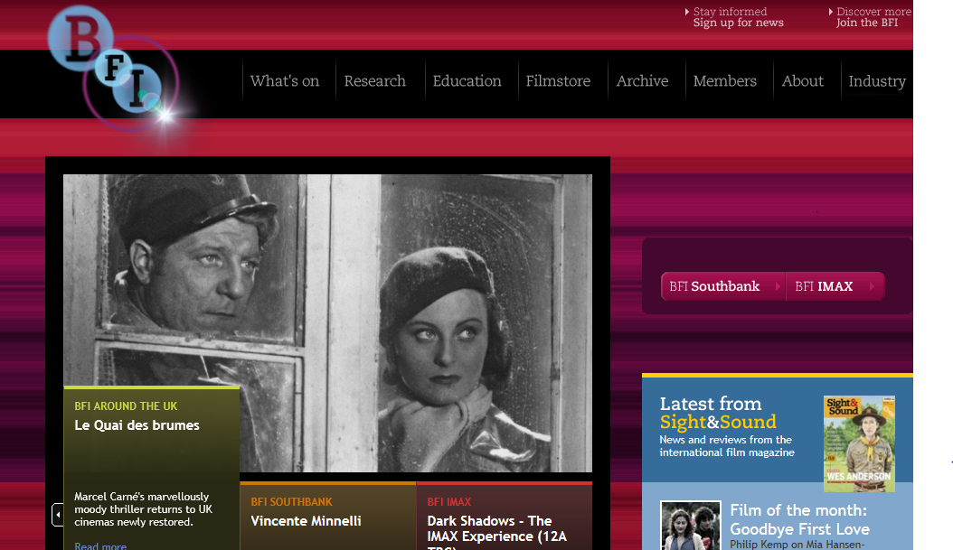

Slide 23
BFI:
“The art, history and impact of film”
60,000 fiction film titles
Ephemera, including 15,000 posters
Television (selective)
600 special collections
- new website next month

Slide 24
The obstacles for our national archives:
Rights
Metadata
Funding
Core purpose
Rights

Slide 25
These collections are not the equivalent of our major libraries.
There is no legal deposit for moving image or sound content.
There is no public entitlement to access.

Slide 26
Six propositions:
Moving image is central to our understanding of the 20th Century
Due to increasing demand, significant resources are now available online
Our major archives are not equipped to deliver the value locked up in them
We need the analytic methods and research framework to consider moving image in the same terms as text
New initiatives are changing the context for our national collections
We have the opportunity to imagine a new future

Slide 27
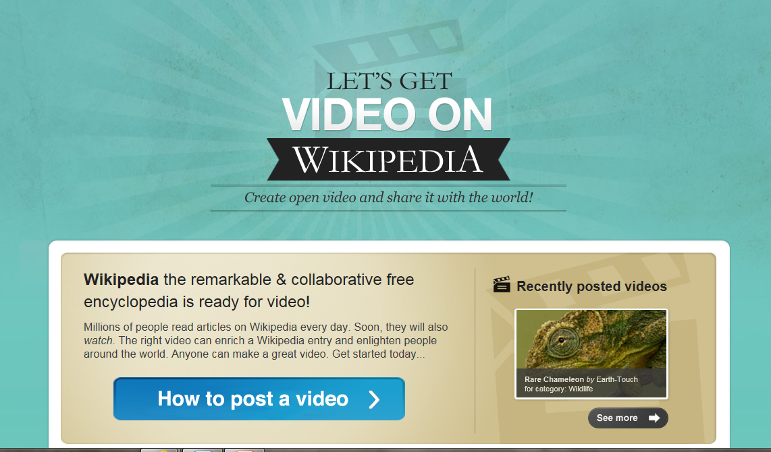

Slide 28
What do we want from text?
What do we need from moving image?

Slide 29
TEXT v FILM
DISCOVERABLE

Slide 30
TEXT v FILM
RETRIEVABLE/ACCESSIBLE

Slide 31
TEXT v FILM
ABILITY TO ANALYSE

Slide 32
TEXT v FILM
REVIEWABLE

Slide 33
TEXT v FILM
QUOTEABLE

Slide 34
TEXT v FILM
SEARCHABLE

Slide 35
TEXT v FILM
RESEARCHABLE

Slide 36
TEXT v FILM
OPEN
TO PRIMARY SOURCES

Slide 37
TEXT v FILM
CITEABLE

Slide 38
TEXT v FILM
A
PERMANENT
RESOURCE

Slide 39
TEXT v FILM
INSPIRE
CREATIVITY

Slide 40
TEXT v FILM
SHAREABLE

Slide 41
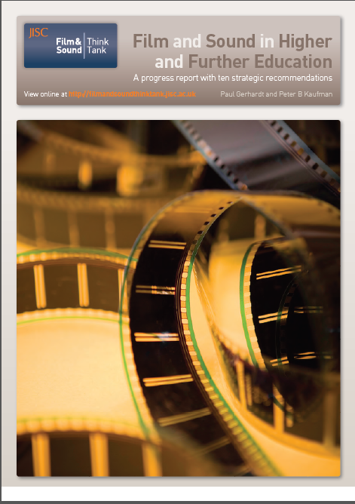

Slide 43
Six propositions:
Moving image is central to our understanding of the 20th Century
Due to increasing demand, significant resources are now available online
Our major archives are not equipped to deliver the value locked up in them
We need the analytic methods and research framework to consider moving image in the same terms as text
New initiatives are changing the context for our national collections
We have the opportunity to imagine a new future

Slide 44
A shared vision of the future
Imagine that much of the UK’s publicly-held cultural and heritage media assets and data could be found in a unified online space… (connected together, searchable, open, accessible, visible and usable in a way that allows individuals, institutions and machines to add additional material, meaning and context to each other’s media, indexed and tagged to the highest level of detail)

Slide 45
The Digital Public Space
An emerging vision of a free-to-everyone, open access environment for learning and creative endeavour

Slide 46
Partnerships
The National Archives
Royal Opera House
British Library
The Open University
British Film Institute
National Library of Scotland
JISC
Arts Council England
Royal Botanic Gardens at Kew
National Maritime Museum
Science Museum
Public Catalogue Foundation (representing UK galleries)
BBC

Slide 47
Changing landscape for IP:
Hargreaves review
EU and orphan works
Extended educational licensing

Slide 48
The Artist in the Archive

Slide 50
“BBC in the East End updated”
a film by Chris Dorley-Brown

Slide 51
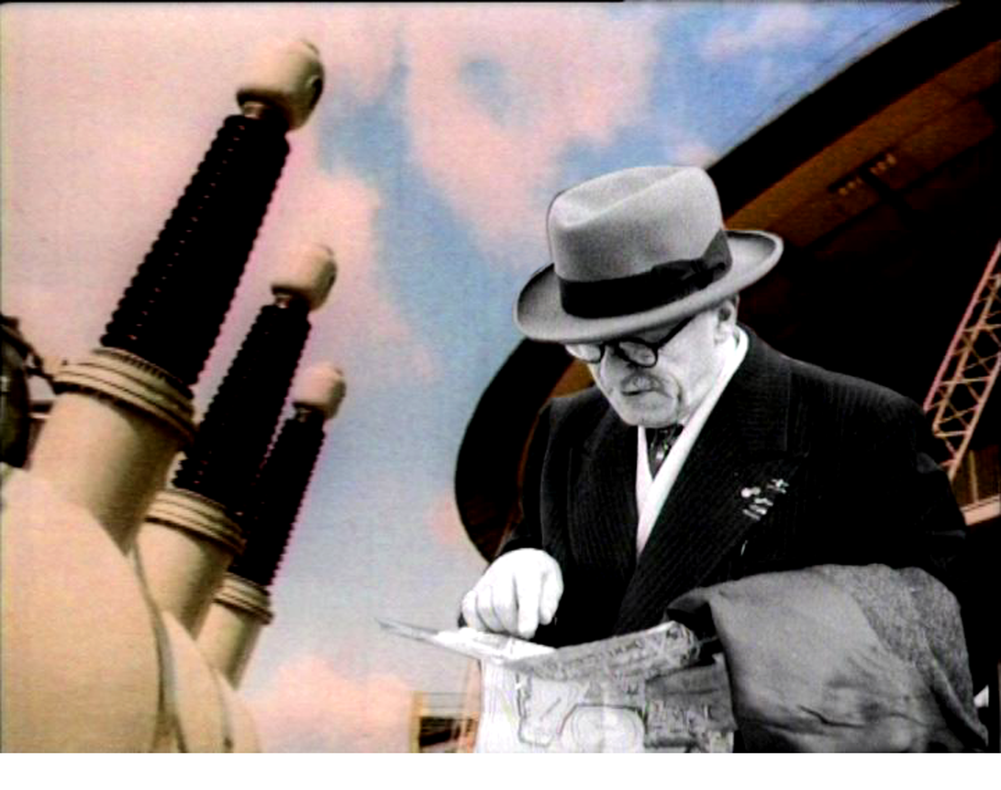
Trying Things Out
a film by
Vicki Bennett

Slide 52
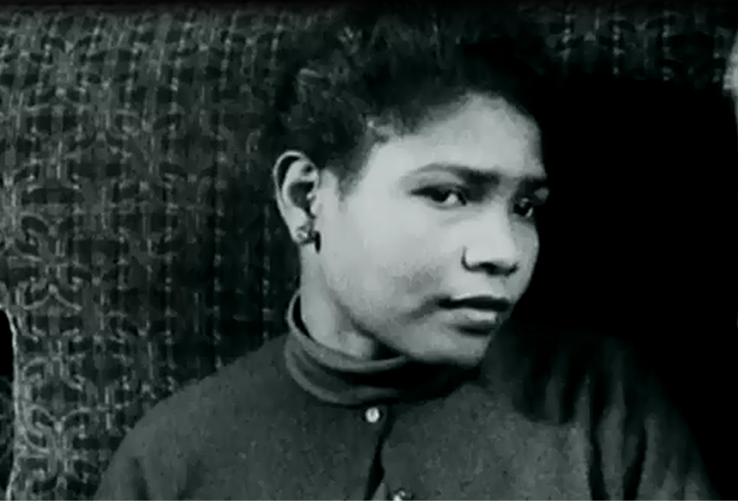
Mnemosyne

Slide 53
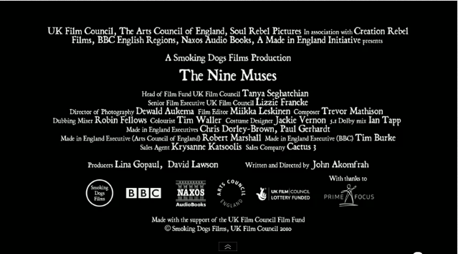

Slide 54
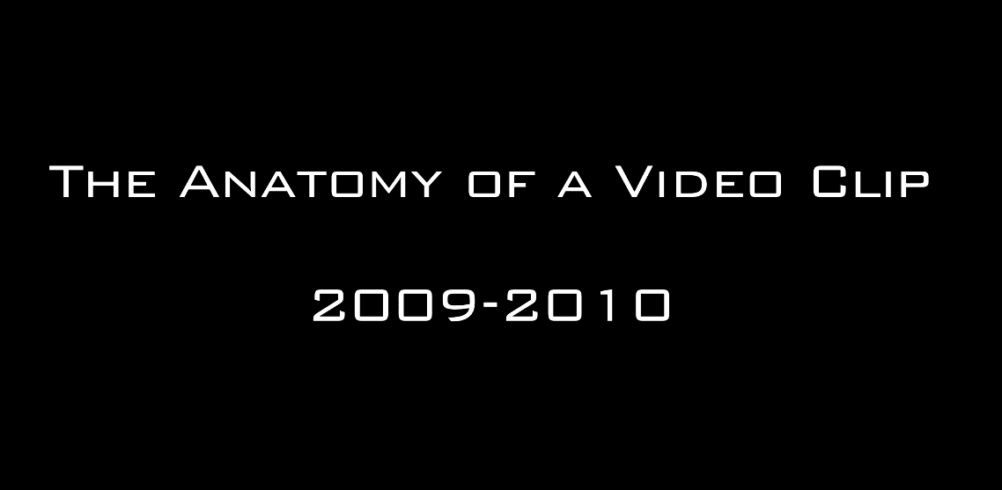

Slide 55
Six propositions:
Moving image is central to our understanding of the 20th Century
Due to increasing demand, significant resources are now available online
Our major archives are not equipped to deliver the value locked up in them
We need the analytic methods and research framework to consider moving image in the same terms as text
New initiatives are changing the context for our national collections
We have the opportunity to imagine a new future

Slide 56
What will be the main features of a future where moving image resources are open and discoverable to all?

Slide 57
What will be the main features of a future where moving image resources are open and discoverable to all?
Educational licensing will be extended to all collections

Slide 58
What will be the main features of a future where moving image resources are open and discoverable to all?
Educational licensing will be extended to all collections
Underlying rights will be transparent

Slide 59
What will be the main features of a future where moving image resources are open and discoverable to all?
Educational licensing will be extended to all collections
Underlying rights will be transparent
Closed collections will become living archives or open memory centres

Slide 60
What will be the main features of a future where moving image resources are open and discoverable to all?
Educational licensing will be extended to all collections
Underlying rights will be transparent
Closed collections will become living archives or open memory centres
We will value and collect primary material (rushes, unedited interviews)

Slide 61
What will be the main features of a future where moving image resources are open and discoverable to all?
Educational licensing will be extended to all collections
Underlying rights will be transparent
Closed collections will become living archives or open memory centres
We will value and collect primary material (rushes, unedited interviews)
We will acknowledge the video essay and the moving image footnote

Slide 62
What will be the main features of a future where moving image resources are open and discoverable to all?
Educational licensing will be extended to all collections
Underlying rights will be transparent
Closed collections will become living archives or open memory centres
We will value and collect primary material (rushes, unedited interviews)
We will acknowledge the video essay and the moving image footnote
Our libraries of moving images will become the source of new creativity for teaching, learning and exhibition

Slide 63
thank you very much
paul.gerhardt@archivesforcreativity.com

