Slide 1
New ESRC Research Seminar Series
Digital Policy:
Connectivity, Creativity and Rights

Slide 2
James Moxey
Co-Director/Research Director
CIRIC
Creative Industries Research and Innovation Centre
Swansea Metropolitan University

Slide 3
Arrested Development . . .

Slide 4
What kind of digital future is envisaged in Britain?

Slide 5
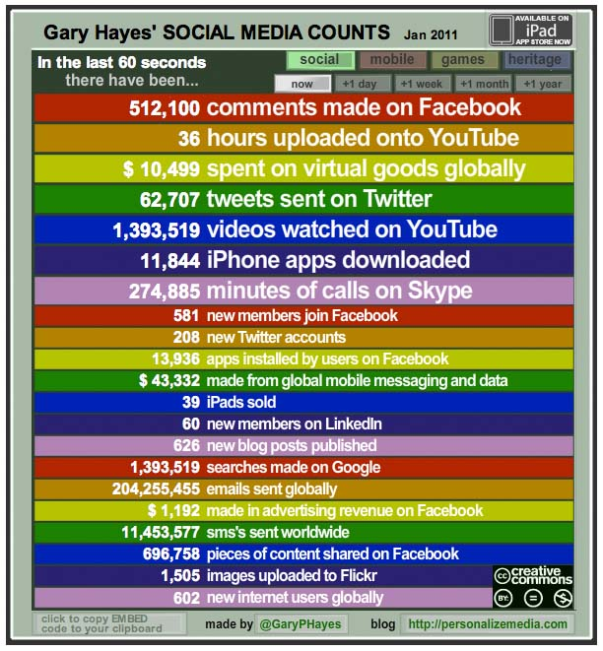

Slide 7
Who continues to be left out or at risk in this digital future?

Slide 8
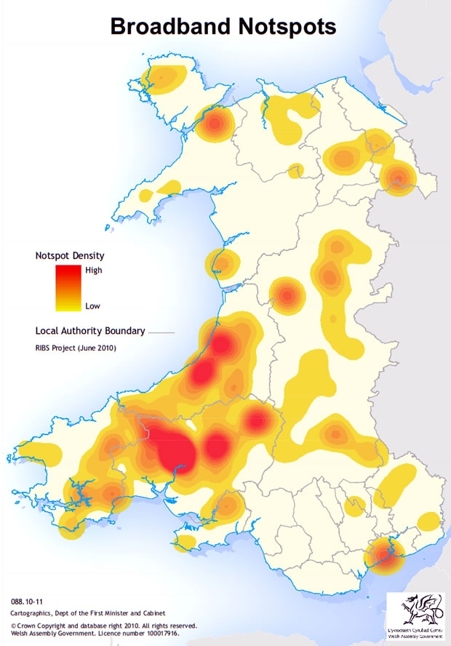

Slide 11
What new kinds of creativity and innovation are being unleashed by digital change and how can these be expanded? . . .

Slide 12
. . . and what can be done to overcome major technical, knowledge and skills barriers to this?

Slide 13
A4B
Knowledge Transfer Centre (KTC)

Slide 14
CIRIC
1 Consolidate and assemble resources
(staff, facilities, knowledge)
2 Publicity
(targeted, networking, agency, advocacy)
3 Diagnostic
(application, contact, filter, reality, outputs)

Slide 15
CIRIC
4 Scoping
(values, commerce, creativity, track record, capacity)
5 Research
(markets, business model, technology, income streams)
6 Development
(tests, refinement, pilot, polish, prototype)

Slide 16
Current Projects in TV, Film, Interactive …
Tasters
IPhone + IPad Apps
Social Networking
Interactive Publishing
Pilots
Story Bibles
Mini Games

Slide 18
Diolch yn Fawr Iawn

