Slide 1
peoplesvoicemedia.co.uk Gary Copitch Chief Executive gary@peoplesvoicemedia.co.uk

Slide 2
Who are we
Specialise in Social Media and Community Engagement
Work across the UK and Europe
A Not For Profit Community Development Organisation
Been in operation since 1995

Slide 3
Definition of Social Media
Social Media allows communities to
produce the content
they want to produce
using, blogs, podcasts,
video, pictures,newspapers
Social Networking sites
Plus: community radio, looking local,
Community Channel, community web sites
Internet radio, Internet TV, blogs

Slide 4
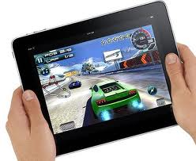
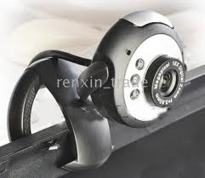
We use technology in
the pocket devices

Slide 5
Community Reporters

Slide 6
What do we mean by Voice
“ People generally base what they believe from what they have experienced or heard through the media. In this sense perception quickly becomes reality ....
Community Cohesion 7 steps Home Office 2005
"I believe that we need more thinking to create sustainable communities, and the right to describe their own reality is one of them“ Simon Safari Chair of the Tenants' Association in Botkyrka Stockholm

Slide 7
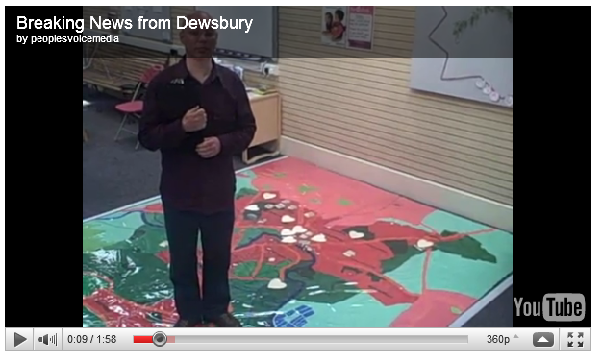
Changing perceptions

Slide 8
Changing perceptions

Slide 9
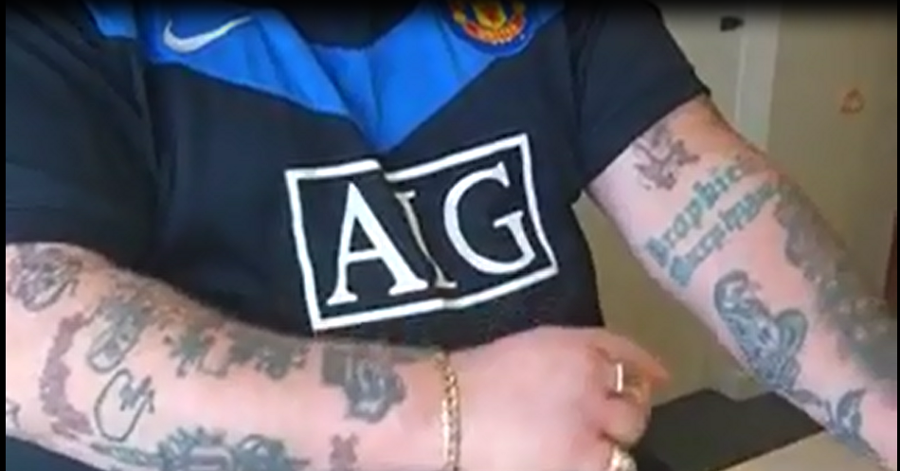
Changing perceptions

Slide 10
Describing their own reality

Slide 11
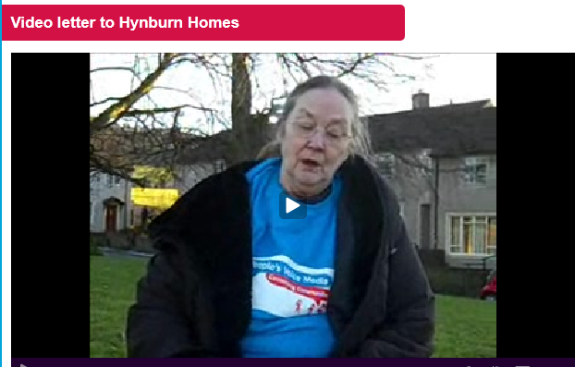
Describing their own reality

Slide 12
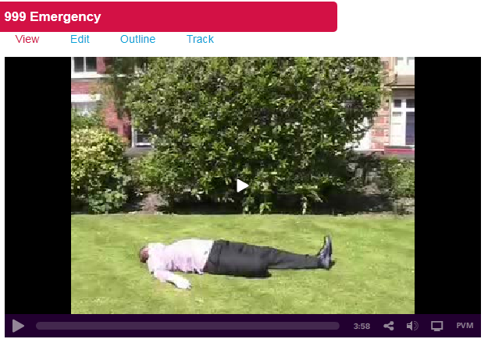
Describing their own reality

Slide 13
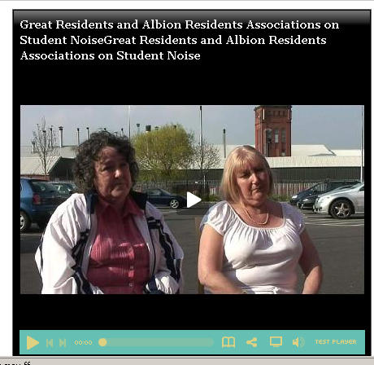
Describing their own reality

Slide 14
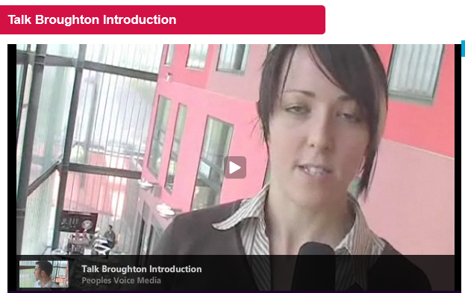
Describing their own reality - Consultation

Slide 15
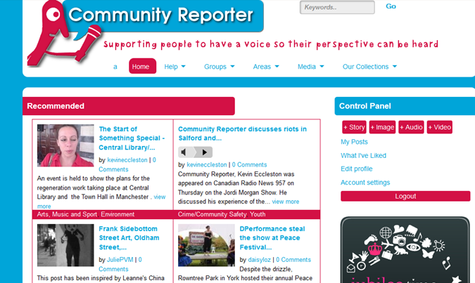
Communityreporter.co.uk

Slide 16
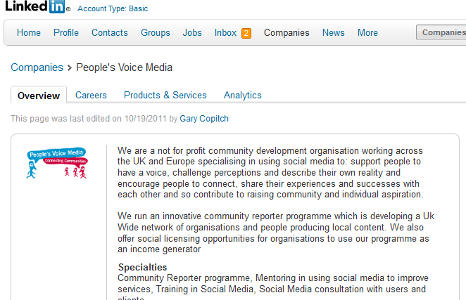
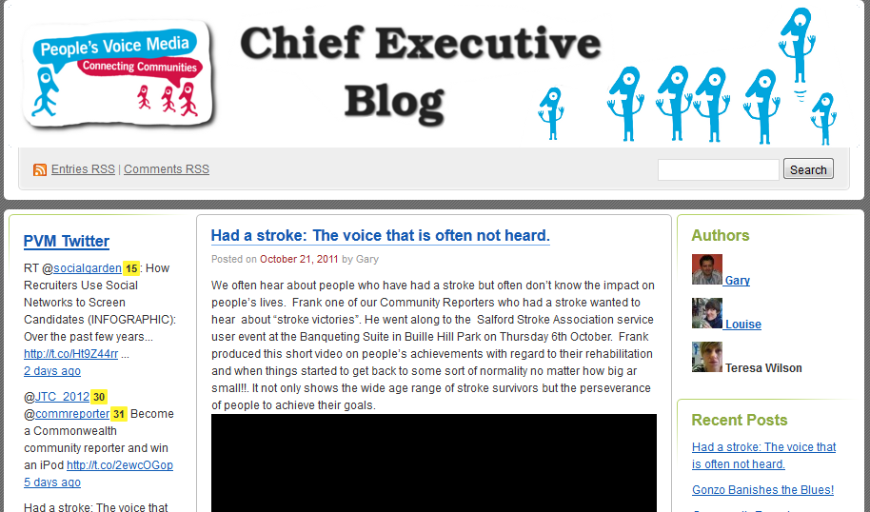
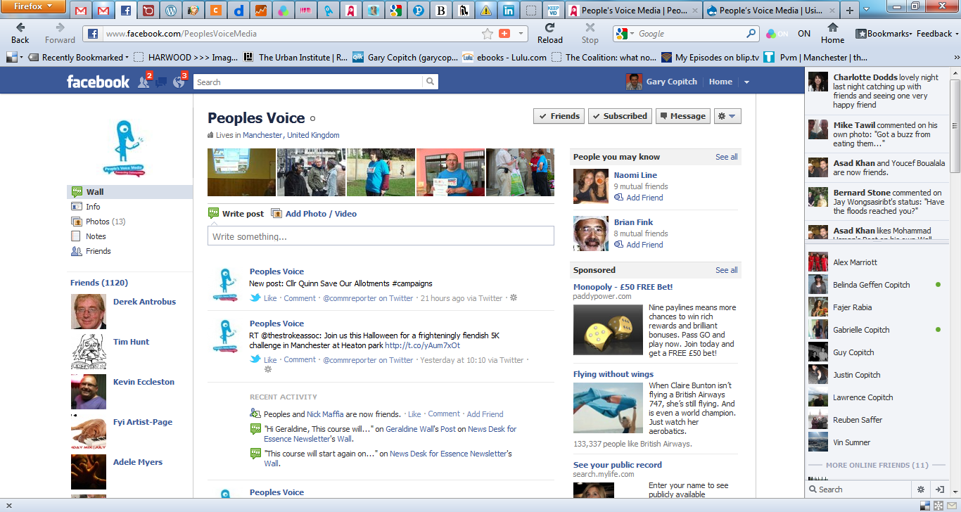
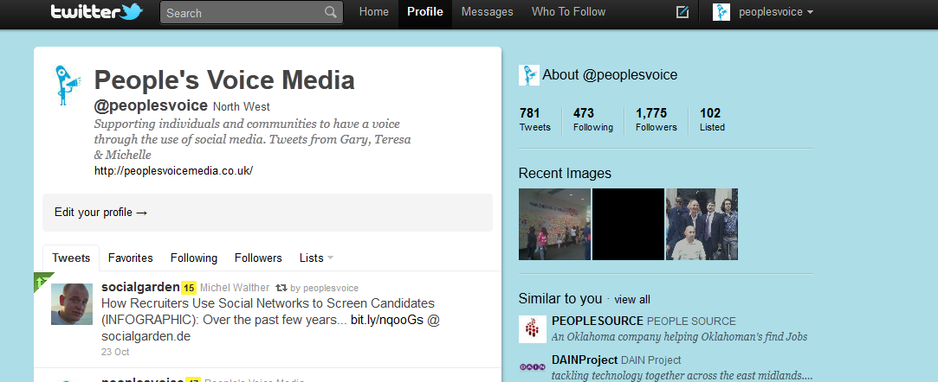
Other channels

Slide 17
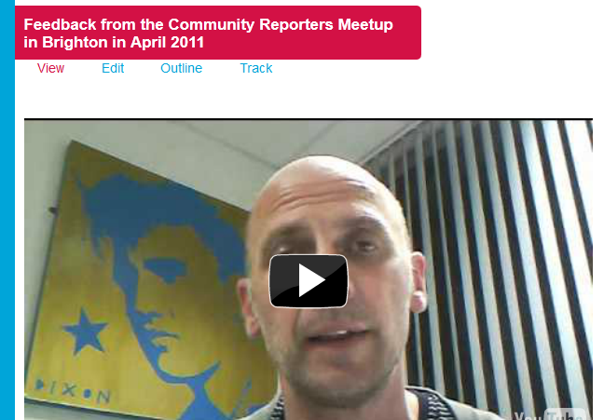
Belonging
Monthly Golden Gonzo Award
Notes:
17

Slide 18
Connected
10,000 Community
Reporters telling
good news
Stories
of the community
Notes:
18

Slide 19
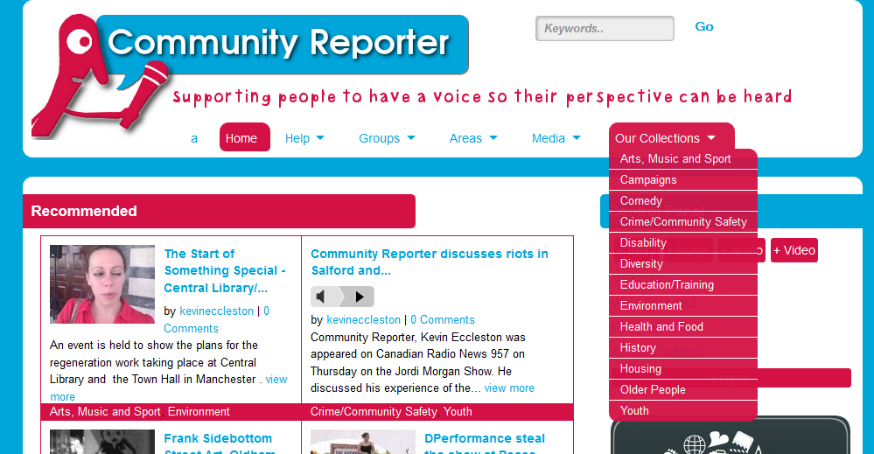
Communityreporter.co.uk

Slide 20
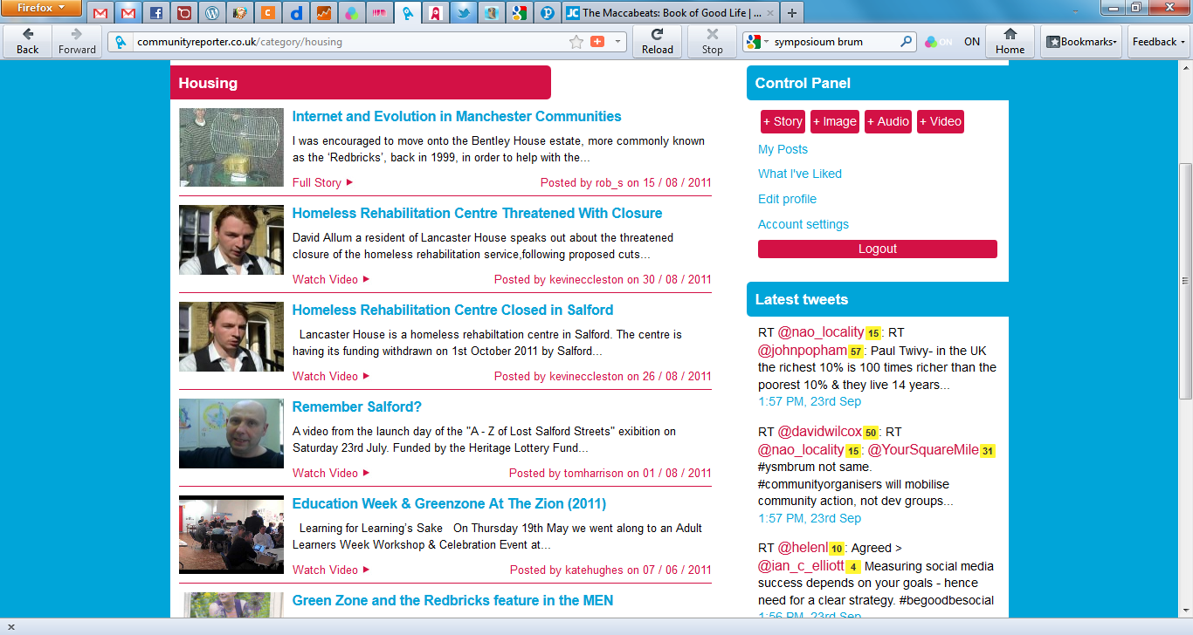
Housing

Slide 21
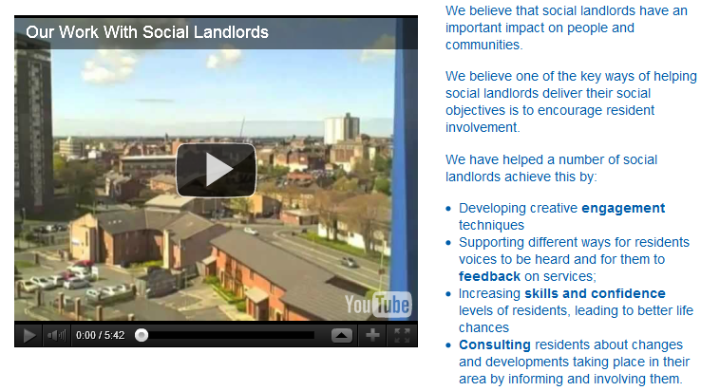
Housing

Slide 22
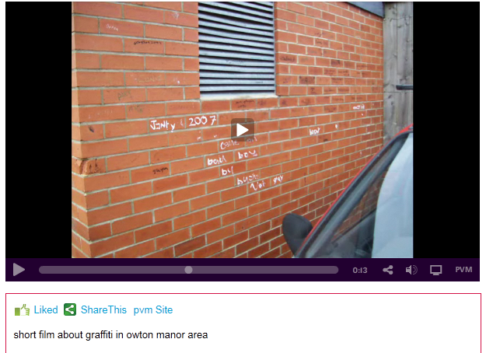
Crime and safety

Slide 23
Crime and safety

Slide 24
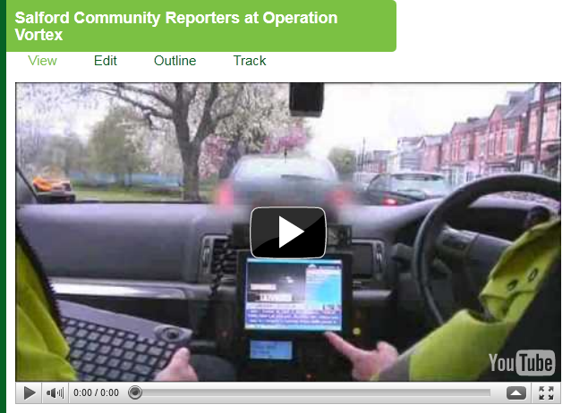
Crime and safety

Slide 25
Crime and safety

Slide 26
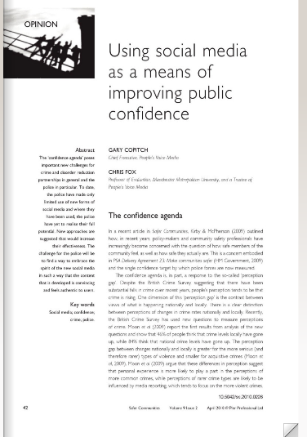
Have a collective reality
Partnership with MMU
To influence policy
Had over 30,000
views

Slide 27
peoplesvoicemedia.co.uk gary@peoplesvoicemedia.co.uk Twitter: @peoplesvoice communityreporter.co.uk mymanchester.net
Thank You!

