Slide 1
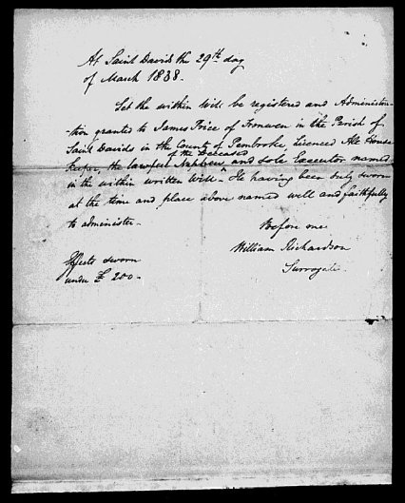
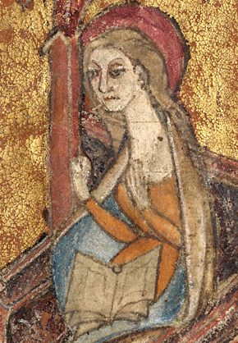
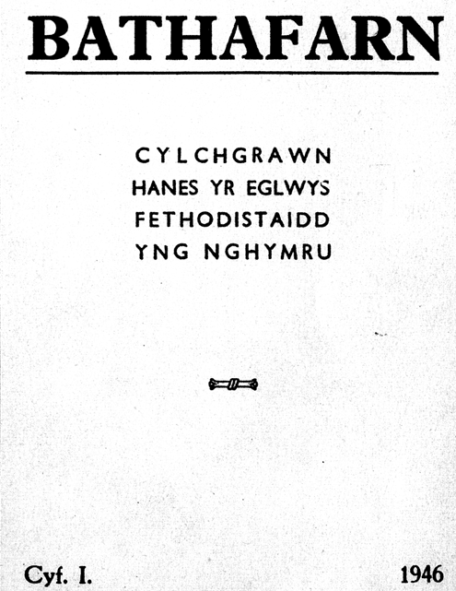
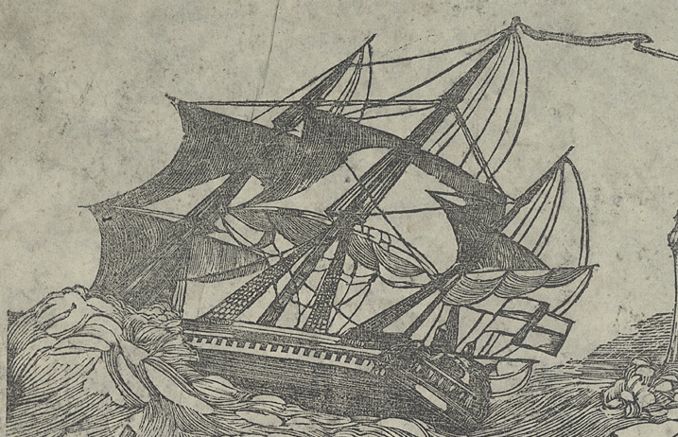
Digital Collections: Use, Value and Impact
Lorna Hughes
University of Wales Chair in Digital Collections, National Library of Wales
Aberystwth University
Department of Information Studies
March 31st 2011
Notes:
Slide 1: title digital images of collections from NLW
I have been asked to "Outline how I see the experience and expertise I’ve gathered hitherto contributing to the development of this post and the enhancement of the National Library of Wales's Digital Collections”.
To do this, I will talk about my experience working with digital collections and e-Research in the arts and humanities, focusing on work that highlights key strategic issues. Specifically, I will address:
issues related to building and using digital collections for research, teaching and community engagement;
developing a research programme around these collections;
and developing publications.
I will also consider some areas where there will be challenges and opportunities to address. I’ll present some thoughts about how these ideas could be taken forward as part of a strategy for digital collections, and for this Post.

Slide 2
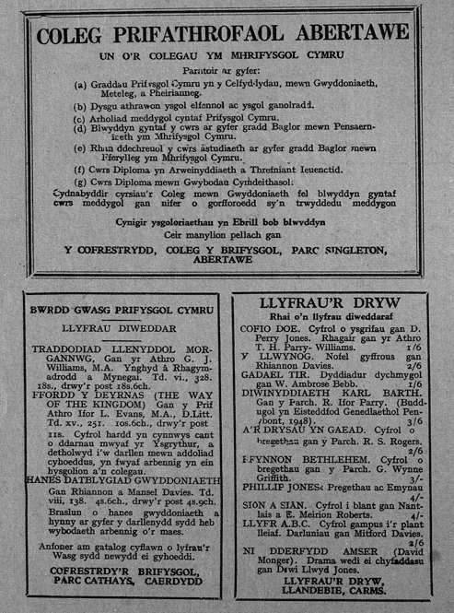
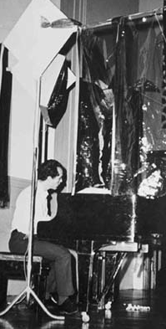
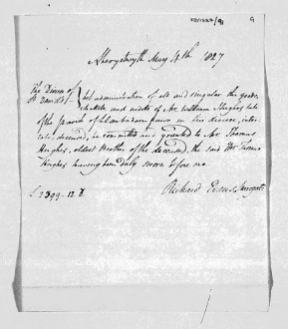
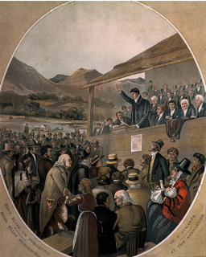
Digital Collections and the NLW
Welsh Journals online
Wills and Probate Records
Federated access
Gathering the jewels
The People’s Collection Wales
www.arts-humanities.net
Performance Art in Wales
Imaging the Bible in Wales
Notes:
Slide 2.: images of NLW collections:
Over the past 20 years, there has been an enormous public and private investment in digital collections, in Libraries, Museums, Archives and Universities.
This has led to a considerable increase in the volume of digital material produced by, and available to, arts and humanities researchers. Given that the source materials for arts and humanities scholarship are varied and complex, their digital surrogates are highly multimedia.
This massive expansion of digital resources is comparable, in its complexity if not volume, to the “data deluge” experienced by the “hard" sciences in the same period. This has created what the AHRC, in the review of their resource enhancement programme, have referred to as a “sea change” in the production and exploitation of resources, in the arts and humanities".
The images in this slide are key examples of digital collections from the NLW. They show innovation and strategic thinking in digital collections development - for example, by setting up mass digitization initiatives for e-Journals and Historic Newspapers, and not going the path of Google digitization; and addressing family history demand with projects like the Wills online.
These collections contribute to the critical mass of digital resources that is now available to Arts and Humanities researchers, offering tremendous opportunity for the National Library and University of Wales to fulfill the vision of the ACLS cyberinfrastructure report: “to reintegrate the cultural record, connecting its disparate parts and making the resulting whole available to one and all, over the network”.

Slide 3
Digital Collections and the NLW
Strategic investment in digitization
“we have the opportunity to reintegrate the cultural record, connecting its disparate parts and making the resulting whole available to one and all, over the network”. (ACLS Cyberinfrastructure report)
Free access to Welsh digital collections
WAG funding, e.g., “The People’s Collection”
Mass digitization: Newspaper Digitization, Welsh Wills
Reasons for digitization:
Access: broader and enhanced, to a wider community
Supporting preservation
Collections enhancement
Institutional and strategic benefits
Research and Education
Focus on
Best practice for digitization workflows
Metadata to describe, explain and locate content
Infrastructure systems for archiving digital data
Notes:
A strategic approach to digitization, but also a holistic one that sees the digital life cycle as a process to be tended, in order to produce a digital library for Wales: “a truly national online knowledge service available freely to every Welsh citizen’.
The National Library and other Welsh institutions took an early interest in digitization, in a strong collaborative framework. Much of this has been directly driven by the Welsh Assembly Government\; eg, the creation in 2004 of CyMAL as a policy division of the Welsh Assembly Government to foster collaboration between libraries, museums and archives
These collaborative activities have been actively facilitated and promoted by the National Library, and and perhaps helps explain why patterns of digital library provision in Wales are less fragmented than in some other areas of the United Kingdom. The extent and effectiveness of collaboration among the Welsh libraries is very striking and suggests that strategically-directed partnerships can be very important in developing successful digitisation projects which achieve major impact.
The NLW approach to digitization is both strategic and holistic, focussing on best practice and sustainability

Slide 4
Digital Collections: Research Development and Collaboration
Building sustainable digital resources
Develop strategic digitization initiatives, in partnership with academics
Develop digital projects based around humanities research questions
Foster interoperability and re-use of collections
Extracting value and impact from digital collections through use for research
Build a collaborative research programme
Around existing and emerging digital resources
Engagement with academic communities: at Canolfan, nationally and internationally
A focus for digital humanities in Wales
Develop training and postgraduate work
Building Communities of practice around ICT methods, through ESF Network in Digital Humanities, Network of Centres, ADHO, WHELF, etc.
Foster engagement with the public
Education, training and culture around NLW collections
Knowledge exchange with businesses: digitizaton, digital asset management and use
Develop Strategic partnerships and approaches to funding
AHRC, JISC, ESRC, EPSRC, Digging into Data, EU funding, etc..
Notes:
This slide describes my role, and how it can inform the development of a strategy for digital collections development?
Sustainable digital collections are at the heart of this work.
The development of new digital content will create a focus for digital humanities expertise in Wales.
It can form the core of a collaborative research programme, working with academics at the Canolfan and other academic departments in Wales, as well as other libraries, museums, and archives in strategic research partnerships.
To develop this, it will be necessary to work closely with the scholarly groups who engage with the collections to identify new opportunities for content creation projects. However, even more important will be developing and disseminating e-Research approaches to using and enhancing existing content to create transformative research across the disciplines. Exploring the linked and semantic data agenda will enable content to be opened up in new ways. Working with communities of cyberscientists, too, will enable new work to emerge in transcribing and annotating resources, and promote public engagement with the institution and its collections.
At the core of this activity is collaboration. Wales already has highly successful models of collaboration, including WHELF, and the Welsh Repositories Network, and successful projects including Gathering the Jewels and the Netlibrary. This collaborative spirit will enable the new research programme to flourish.
Pragmatically, it is also important to mention the Economic downturn. With cuts in the public sector, there will be far less funding for digital projects. New projects must have compelling and visible impact. It will be necessary to be creative about the sort of funding available – the “usual suspects” for digital collections projects, JISC and the AHRC, may no longer be viable. To obtain funding it will be necessary to look further afield, both internationally and in disciplinary focus,

Slide 5
Researching Digital Collections: Use, Value and Impact
Who uses Digital Collections? What do they use them for? What is the impact of digital collections: on scholarship, teaching, and public engagement?
Institutional impact
Mission of the NLW
Sustainability over the long term
Research impact:
Greater access to materials
Enabling new modes of collaboration and communication
Facilitating the type of research which changes the paradigms of understanding and creates new knowledge :
enabling research that would otherwise be impossible: addressing research questions that would have been impossible to resolve without the use of ICT tools.
asking new research questions, i.e. questions that are driven by insights that were only achievable through the use of new tools and methods.
facilitating and enhancing existing research, by making research processes easier via the use of computational tools and methods
Notes:
This slide describes my role, and how it can inform the development of a strategy for digital collections development?
Sustainable digital collections are at the heart of this work.
The development of new digital content will create a focus for digital humanities expertise in Wales.
It can form the core of a collaborative research programme, working with academics at the Canolfan and other academic departments in Wales, as well as other libraries, museums, and archives in strategic research partnerships.
To develop this, it will be necessary to work closely with the scholarly groups who engage with the collections to identify new opportunities for content creation projects. However, even more important will be developing and disseminating e-Research approaches to using and enhancing existing content to create transformative research across the disciplines. Exploring the linked and semantic data agenda will enable content to be opened up in new ways. Working with communities of cyberscientists, too, will enable new work to emerge in transcribing and annotating resources, and promote public engagement with the institution and its collections.
At the core of this activity is collaboration. Wales already has highly successful models of collaboration, including WHELF, and the Welsh Repositories Network, and successful projects including Gathering the Jewels and the Netlibrary. This collaborative spirit will enable the new research programme to flourish.
Pragmatically, it is also important to mention the Economic downturn. With cuts in the public sector, there will be far less funding for digital projects. New projects must have compelling and visible impact. It will be necessary to be creative about the sort of funding available – the “usual suspects” for digital collections projects, JISC and the AHRC, may no longer be viable. To obtain funding it will be necessary to look further afield, both internationally and in disciplinary focus,

Slide 6
Digital Collections: Emerging Issues
New business models to support and develop digital collections
Changes in the way information is used and managed
New paradigms for scholarship and access
New business models
What are the costs and benefits of digital collections?
Indirect costs savings from digital delivery of services?
What are the increased costs of digital access and preservation?
Building an evidence base for economic ‘value’ of digital collections
Increased potential through infrastructure initiatives, linked data, etc
Increasing pressure on funding for digital collections
Making the case for protecting existing digital heritage, and for new digitization
Policy and rights issues
Freely available digital content?
Enhancement and re-use of existing content
Ensuring that licensing ensures broadest scholarly use
Use of digital resources often unanticipated at the outset; they have value for different communities and disciplines than originally intended

Slide 7
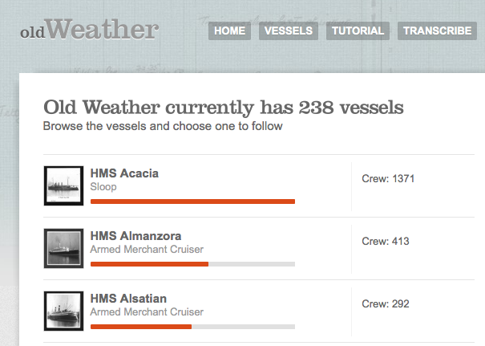
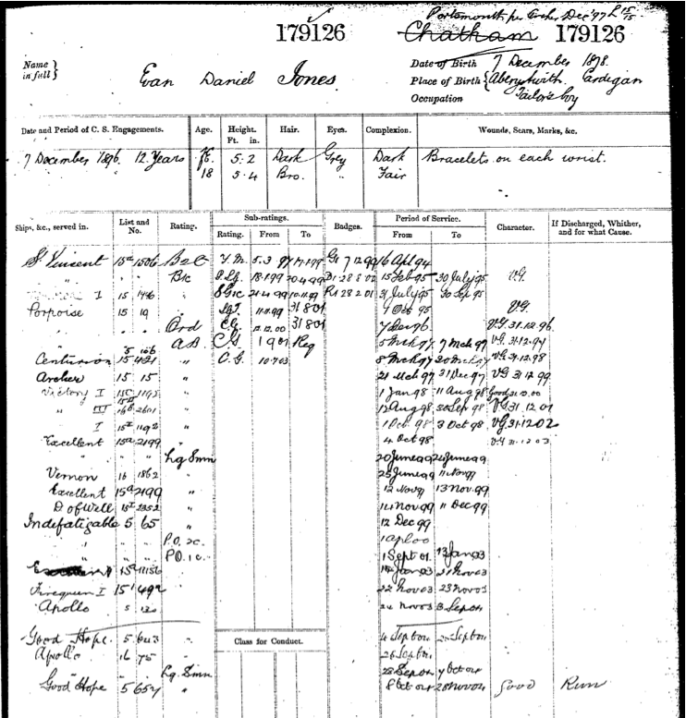
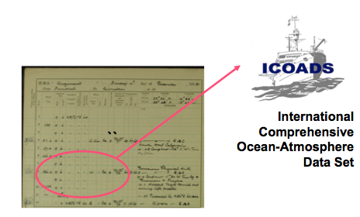
Reusing and Linking data
from disparate sources
TNA, Met Office, KCL, Oxford
Notes:
Slide 9 Historic ships logs: images of ships logs and service records
I recently developed a project to link data in a selection of ships logs to data in Royal Navy service records in The National Archives. This will effectively “put Sailors back in their ships”.
The linked data agenda is of vital importance to the cultural heritage sector. It is a new way of exploring data that can be ‘unlocked’ by deep linking it to other resources.
The arts and humanities lack use cases and demonstrations of the technology, and I hope that SAILS will address this gap. .

Slide 8
Valuable resources enable creativity and research
Support the ‘scholarly primitives’:
Discovering, annotating, comparing, referring, sampling, illustrating, and representing digital content (Unsworth, 2000)
Include text analysis and mining, image analysis, motion capture and analysis, quantitative and qualitative data analysis…
The best resources have been developed in such a way that their use and re-use has been anticipated at the outset,
Digital collections that have been developed in formats that are not “open” are far less likely to be re-used for teaching or research.
Publicly-funded research data are a public good, produced in the public interest
Publicly-funded research data should be openly available to the maximum extent possible
‘The new research that has been enabled by ICT…has depended upon the development of new kinds of resources, such as large corpora in literary, linguistic, musicological, and television and film studies domains, the digitization and digital-encoded representation of materials in classics, history, literature and history of art, and the creation of databases in archaeology and the performing arts. This recognition that the future generations of scholarship in the arts and humanities will depend upon the accessibility of a vast array of digital resources in digital form is becoming more widespread’ (Hockey and Ross, 2008)

