Slide 2
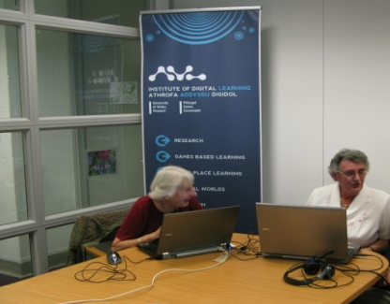
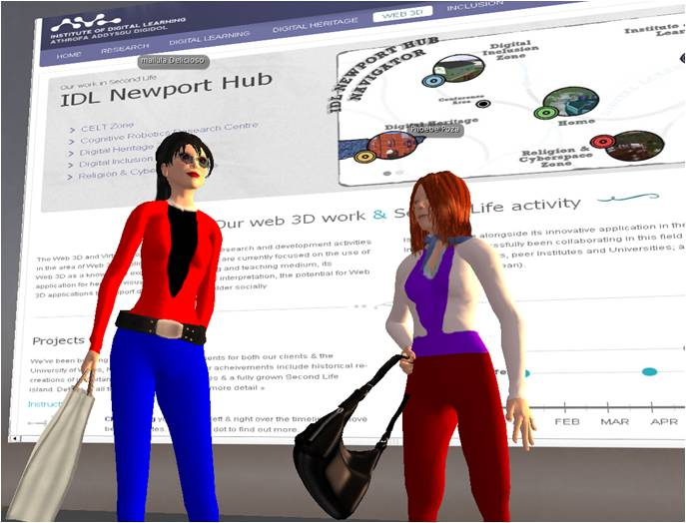
University mission
IDL expertise – creative application
of digital technologies
Gaer Community
Third Sector partnership
NEWPORTDIGITAL: Community
Empowerment through Digital Inclusion study ‘09
Public engagement – Web 3D and Welsh Communities
Pilot study for Big
Lottery
Advantage call

Slide 3
OFCOM’s Next Generation Services for Older and Disabled People Final Report, 2010
OFCOM’s Digital Lifestyles Final Report, 2010
Delivering Digital Inclusion:
A Strategic Framework for Wales, 2010
Gaer Community recognition of power of internet tools in addressing community issues
Web 3D use by communities of interest to support client socialisation needs e.g. NAS

Slide 4
OFCOM’s Next Generation Services for Older and Disabled People Final Report, 2010
The construction of online communities could be improved to provide more engaging, high quality, virtual and accessible multi-sensory spaces that people would enjoy inhabiting….Virtual environments may become more common meeting places to enhance social contact and reduce social isolation.
Delivering Digital Inclusion:
A Strategic Framework for Wales, 2010
Digital inclusion is about ensuring that people, both as citizens and consumers, benefit from the rapid pace of technological change that is taking place in our society. This especially applies with people being able to use the internet in ways that will enhance their lives and contribute to helping them overcome other disadvantages which they might face.

Slide 5
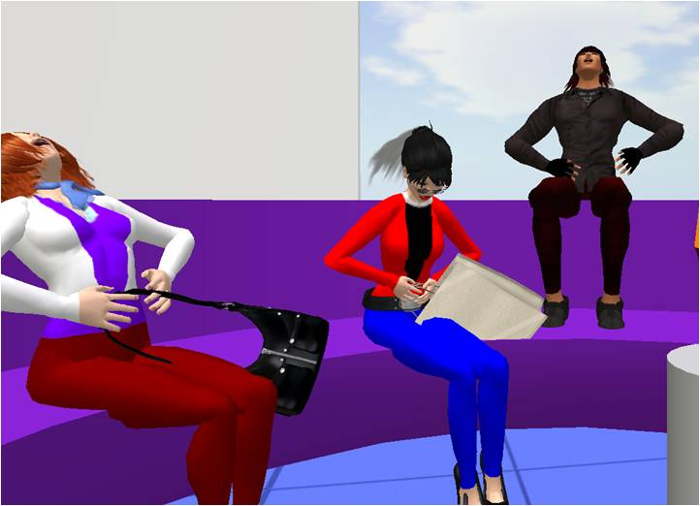
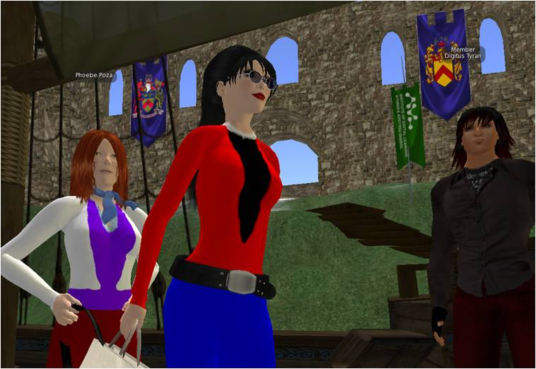

Slide 6
Design of the virtual spaces visited were
regularly not to the participants tastes.
The skills of effective use of SL were picked up
quickly but there is opportunity to simplify
these further in future studies.
Participants choose to represent themselves as youthful avatars and were very stimulated by talking with other people from around the virtual world.
Participants identified with their avatars as real rather than virtual digital beings and there was a strong sense of personification and connection with the self generated digital characters.
Participants were quick to see the potential of the medium to socialise from the comfort of their own home and undertake virtual trips with members of their community around highlighted SL landmarks like museums and the Virtual Paris of 1900.

Slide 7
Multi-user virtual environment explored as a positive technology in addressing social isolation and support ageing well in the information society.
Digital Avatars can be used as tools for mental stimulation and playful social interaction for older age groups.
Responsive Welsh HEI innovation study – IEEE Conference & Journal, Athens, May 11
SL –a tool for continued social contact during periods of darkness when older community members experience fear and anxiety in leaving their homes?
New digital economy opportunity – community focused independent living and leisure services

Slide 8
