Slide 1
Digital Literacy and Self-Regulation Online: Insights for Policy
Digital Literacy and Informed Learning
Josie Fraser: Digital Literacy: regulating which self?
#digipol11

Slide 2
BSF in Leicester
Approximately £340 million capital build programme
27 secondary school sites - including Pupil Referral Units, SEN, Hospital school
20,000 Learner places – building works completed by 2015

Slide 3
Where are we heading?
Increasing critical infrastructure, network & connectivity
Into the cloud – services and storage
Learner Owned devices
Use of technology to support energy reduction
Increasingly school-centred decision making and budgets
Current flux regarding curriculum & indicators
Lack of national commitment to technology for education

Slide 4
Strategic priorities
space & place
workforce development & innovation
networked learning & communities
information management
green ICT
e-safety & e-citizenship

Slide 5
Notes:
EU Kids Online – Slide from Safer Internet Forum Presentations, October 2010
http://www2.lse.ac.uk/media@lse/research/EUKidsOnline/PresentationsSIF2010.aspx

Slide 6
Access to the internet
Notes:
http://stakeholders.ofcom.org.uk/binaries/research/media-literacy/media-lit11/childrens.pdf
One in twelve children do not use the internet at all, in any location While the main focus of our analysis is upon children’s use of the internet at home, we are also interested in whether children use the internet anywhere else, for example, at school, at a library, at the houses of relatives or friends, or via a portable device such as a portable media player, games player or mobile. Figure 8 shows where the internet is used by 5-7s, 8-11s, 12-15s, and how this has changed over time. Four distinct groups are shown: those who use the internet at home (and may well use it elsewhere); those who use it elsewhere (and may well use it at school but not at home); those who use it only at school; and those who don’t use it at all.
The incidence of using the internet at all (in any location) through any device has not changed for any age group since 2009, and accounts for around four in five 5-7s (79%), over nine in ten 8-11s (95%) and almost all 12-15s (98%). A higher proportion of children aged 8-11 and 12-15 use the internet at home compared to 2009; now accounting for four in five 8-11s (82% vs. 76% in 2009) and nine in ten 12-15s (90% vs. 84%).

Slide 7
Notes:
Ofcom: UK children’s media literacy April 2011 http://stakeholders.ofcom.org.uk/binaries/research/media-literacy/media-lit11/childrens.pdf

Slide 8
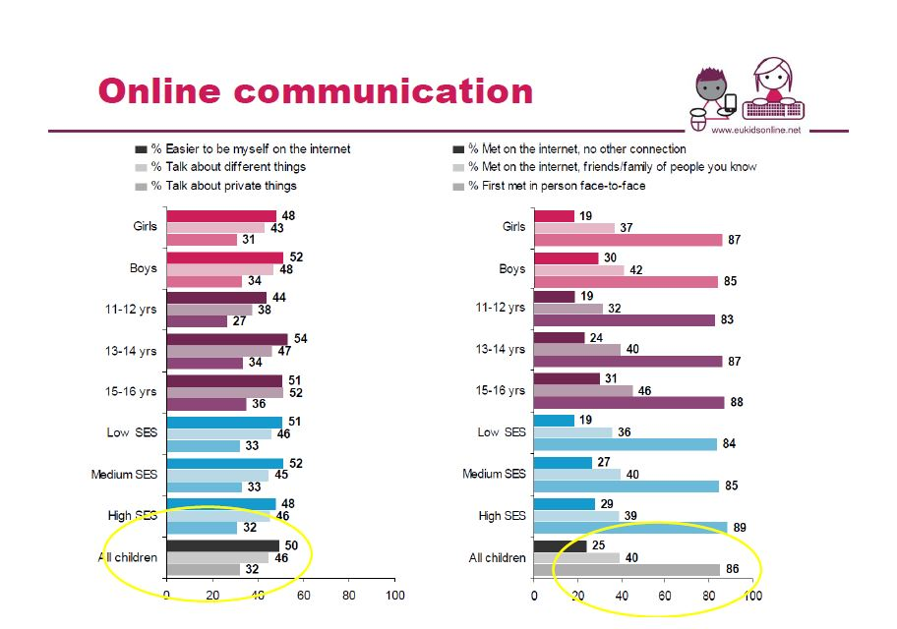
Notes:
EU Kids Online – Slide from Safer Internet Forum Presentations, October 2010
http://www2.lse.ac.uk/media@lse/research/EUKidsOnline/PresentationsSIF2010.aspx

Slide 9
Notes:
Second Life, Women, Cheerleaders Uploaded on June 7, 2008 by yukali http://www.flickr.com/photos/yukali/2558486520/

Slide 10
Digital Literacy =
digital tool knowledge +
critical thinking +
social engagement

Slide 11
“& then in the last 5 or 6 years, blogging has taken off in a huge way and all these different services that have people sharing all this information. People have really gotten comfortable not only sharing more information and different kinds, but more openly and with more people. That social norm is just something that has evolved over time.“
Mark Zuckerberg, January 2010
Notes:
Facebook: 'closed' network to indexed network http://www.readwriteweb.com/archives/facebooks_zuckerberg_says_the_age_of_privacy_is_ov.php January 9, 2010
New Facebook user defaults are set to public - Your name, profile picture, gender, current city, networks, Friends List, and all the pages you subscribe to

Slide 12
How can we make sure that digital literacy programmes don’t further disadvantage already disadvantaged learners?

Slide 13
Thank you!

