Slide 1
Public Policy Impact in the Arts and Humanities
‘Sensing Endings’ TECHNE Conference, 25-26 June 2018
Dr Beatrice Turner, Research Manager for Impact and Environment, Roehampton University
beatrice.turner@Roehampton.ac.uk

Slide 2
What is public policy?
‘The actions of government and the intentions that determine those actions’
(Cochran et al in Birkland, 2005: 18)
‘Public policy can be generally defined as a system of laws, regulatory measures, courses of action, and funding priorities concerning a given topic promulgated by a governmental entity or its representatives.’
(Kilpatrick, ‘Defining Public Policy and the Law’)
‘Public policy […] is a composite of different processes that cross-cut most branches of government and involve many decision makers.’
(John, 1998: 9)

Slide 3
Who makes public policy?
The executive branch of government
The legislative branch
Central government departments and the civil servants who work in them
Political advisors and political parties
International organisations (UN, WHO, European Commission…)
Local government
Third sector
Special interest groups/lobbyists
Members of the public
and, of course, academics

Slide 4
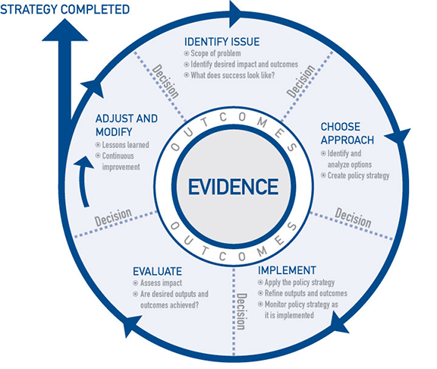
Policy development is a continuous cycle
Multiple points of entry
Multiple actors you can engage with
Different actors appropriate to different stages

Slide 5
Why public policy impact?
Potential for impact is extremely high
Your research can genuinely help solve problems society faces
Urgent need for unique perspectives offered by arts and humanities disciplines to inform public policy
Your own research can be transformed in surprising and wonderful ways through collaboration with policymakers

Slide 6
'For the purposes of the REF, impact is defined as an effect on, change or benefit to the economy, society, culture, public policy or services, health, the environment or quality of life, beyond academia'
(HEFCE et al 2012a)
Notes:
REF definition puts public policy alongside economy, society etc, but it also affects all of those things – and arguably IS all of those things
We expect a similar definition for 2021 REF from Research England which replaces HEFCE

Slide 7
‘Literary Thinking and psychosis’ impact case study
Professor Pat Waugh and Dr Angela Woods (English Literature, Durham University) explore how trauma or psychosis is registered in the ‘inner voice’ of Modernist fiction
Working with academics in Psychology and clinicians and counsellors at the Tees Valley NHS Trust, they used these literary critical insights to develop new bio-cultural model for understanding paranoid schizophrenia and ‘voice-hearing’
Narrative model places voice-hearer’s experience alongside clinician’s diagnosis
They developed narrative-based therapies for patients, and training for clinicians. These are now used by NHS Trusts and the Doctorate in Clinical Social Care at Rutgers University
http://hearingthevoice.org/

Slide 8
Questions to ask yourself
What has changed as a result of your research/what do you hope will be different?
Which groups will be affected?
Who is responsible for that policy area?
Do the same actors develop, set, implement, and evaluate the policy?
Think outside the obvious disciplinary boundaries

Slide 9
Local Government
Local government implements national policy at local level
Councils evaluate policy impact
Devolved powers mean increasingly they set policy, too (education, transport, arts funding, libraries)
Increasing funding pressures: up to 40% cuts over last 5 years, with more planned
Local bodies increasingly look to partner organisations to develop policy and deliver services

Slide 10
Local government: how to engage
Pick up the phone
Seriously, pick up the phone
Invite policy officers to your seminar/public discussion/exhibition
Get local government involved early: seek comments on your proposals/ideas
Be aware of funding issues when proposing collaboration
Write a 1-page executive summary of your research/proposed project, designed for a lay audience

Slide 11
Central government
Executive branch (Cabinet plus some Ministers of State) sets legislative agenda and strategic priorities
Government departments advise Secretaries of State and develop national policy and legislation
Departments also carry out strategic national overviews, respond to current issues, horizon scan for future issues
Departments are stable, long term, apolitical – in theory!
High impact potential, but very difficult to get an ‘in’
Competing priorities (academics, other departments, other agencies)

Slide 12
Central government: how to engage
Network, go to events
Trust is important, for future collaborations and for getting contacts
Respond to white/green papers (published on gov.uk)
Make use of departmental outreach officers
Government timeframes are much shorter – be prepared to move fast
Communication styles differ hugely – see policy toolkit guidelines
https://www.gov.uk

Slide 13
Parliament: some problems
Parliament scrutinises and passes legislation, holds the government to account, represents the people
An MP who takes up your issue is a powerful ally; a Minister even more
MPs can only receive public communications from constituents about constituency issues
Ministers are a fortress unless you know their Special Advisor/s
Direct political engagement is always high-risk
Lack of control over what the MP does

Slide 14
Select Committees
Politically-balanced group of MPs who consider bills and conduct enquiries within particular remit
All bills go to relevant Select Committee after 2nd reading
Public make submissions, as witnesses or expert witnesses
Submissions and deliberations a matter of public record
Committee report will make recommendations and reflect on evidence received
Committee reports legally non-binding but very influential
Committees carry out special enquiries (Leveson; anti-doping)

Slide 15
Select Committees: how to engage
Check Parliamentary website for upcoming enquiries and bills
Website has advice about how to prepare a submission
Contact Committee staff – suggest an enquiry topic
High-quality impact evidence – especially if you are subsequently invited to give evidence in person as witness
www.parliament.uk
http://toolkit.northernbridge.ac.uk/engagingwithpolicymakers/engagingwithparliament/selectcommittees

Slide 16
‘Protecting cultural property in armed conflict’ impact case study
Professor Peter Stone OBE (Arts and Culture, Newcastle) carried out research into destruction of cultural heritage in armed conflict zones
The Destruction of Cultural Heritage in Iraq (2008) made recommendations for future action based on observations during 2003 invasion
Professor Stone was expert witness to Committee considering Draft Cultural Property (Armed Conflict) Bill 2008 on basis of submission
‘The Committee noted the value of the book in providing an informed context for their deliberations and referred specifically to information in the book in paragraph 9 of the report’ (REF submission)

Slide 17
All-party Parliamentary Groups
Informal groups of MPs and Lords who are interested in a specific topic
3rd sector and academics often sit on APPGs
No formal powers but influential
Commission exploratory research
Easy to contact
https://www.publications.parliament.uk/pa/cm/cmallparty/170502/contents.htm

Slide 18
Third sector actors: charities
Carry out research, lobby, advocate, campaign
Central and local government services increasingly contracted out to charities
Often have excellent networks you can plug into
Sector under intense funding pressure
Offer research, not collaboration
Engage early in research design process – invite comment
Will have own priorities

Slide 19
Third sector actors: think-tanks
Work extensively with politicians and civil service, as well as providing media commentary
Many are highly influential
Carry out and commission research
Many academics have long-standing associations with think-tanks, and they always want to hear from you
Consider image, fit, academic independence

Slide 20
Final points
Make sure you/your research can be found! Develop a strong online profile
Get assistance from your Communications department
Talk to your friendly Research Facilitator/Impact Manager/Research Manager (titles may vary)
http://toolkit.northernbridge.ac.uk
http://www.parliament.uk
http://www.gov.uk
https://www.policy.manchester.ac.uk

Slide 21
Communicating for policymakers
Keep it SHORT (one to three pages)
Key messages/findings/outcomes first
Avoid footnotes, literature reviews, methodologies etc (unless central to your key message)
Plain, jargon-free language
Bullet points
Have a purpose: never send anything ‘FYI’
ALWAYS suggest next steps: what do you want to happen as a result now? In six months’ time? What’s your ideal outcome?

Slide 22
Pitching exercise: executive summaries
A senior civil servant is interested in your PhD research and asks you to send them an executive summary. In ONE page, answer the following:
What is the single most important finding/argument/aim of your research?
What issues can it address, and how?
What groups, individuals, or organisations might be affected?
What are the next steps to make that happen?
What decisions or actions do you want the civil servant to do now that they’ve read your executive summary?

