Slide 1
Digital Policy:
Towards an Agenda for the ESRC Seminar Series
William H. Dutton
Oxford Internet Institute, University of Oxford
Presentation for the Launch Seminar of the Digital Policy ESRC Seminar Series, entitled ‘Digital Wales’, at University of Wales, 1 April 2011.

Slide 2
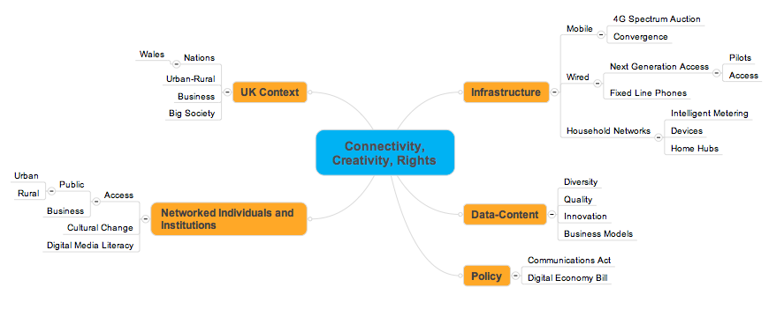

Slide 3
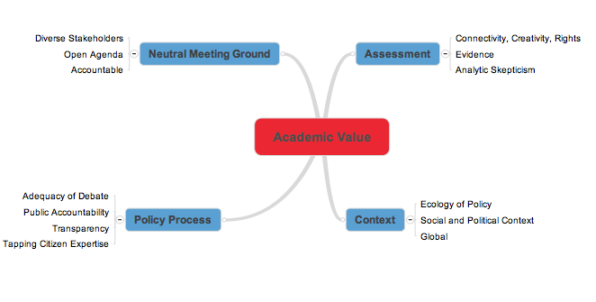

Slide 5
Ecology of Choices Shaping Free Expression

